Slide 1

JavaScript, Fifth Edition
Chapter 9
Managing State and Information Security

Slide 2
Objectives
In this chapter, you will:
Learn about state information
Save state information with hidden form fields, query strings, and cookies
Learn about security issues
JavaScript, Fifth Edition

Slide 3
Understanding State Information
State information
  Information about individual visits to a Web site
HTTP original design: stateless
  No persistent data about site visits stored
Reasons for maintaining state information
  Temporarily store information for a user
  Allow a user to create bookmarks
  Provide shopping carts
JavaScript, Fifth Edition

Slide 4
Understanding State Information (cont’d.)
  Customize individual Web pages
  Store user IDs and passwords
  Use counters
JavaScript, Fifth Edition

Slide 5
Saving State Information with Hidden Form Fields
Hidden form field
  Special type of form element
  Not displayed by Web browser
  Allows information to be hidden from users
  Created with the <input> element
  Temporarily stores data sent to a server along with the rest of a form
  No need for user to see hidden data
Syntax
  <input type="hidden">
JavaScript, Fifth Edition

Slide 6
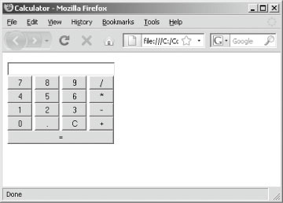
Saving State Information with Hidden Form Fields (cont’d.)
Creating a calculator script with storage functionality
Example exercise:
  Calculator script using push buttons and onclick event handlers
Figure 9-1 Calculator.html in a Web browser
JavaScript, Fifth Edition

Slide 7
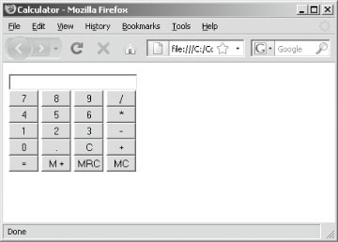
Saving State Information with Hidden Form Fields (cont’d.)
Example exercise:
  Modify calculator to includes storage functionality using a hidden form field
Figure 9-2 Calculator script after adding
storage functionality
JavaScript, Fifth Edition

Slide 8
Saving State Information with Hidden Form Fields (cont’d.)
Using hidden form fields with the Printer Product Registration page
Example exercises:
  Frame-based Printer Product Registration Web page
    Printer Product Registration Web page consists of two Web pages
  Data entered by the user on both forms
    Submitted to Web server simultaneously
JavaScript, Fifth Edition

Slide 9
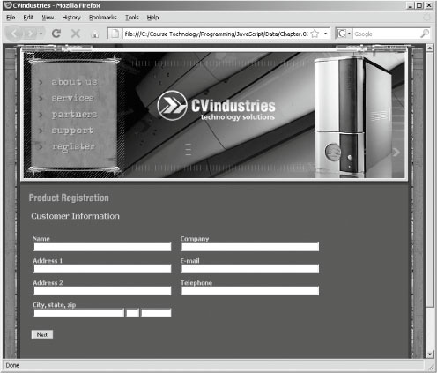
Saving State Information with Hidden Form Fields (cont’d.)
Figure 9-3 Customer Information form of the
Printer Product Registration Web page
JavaScript, Fifth Edition

Slide 10
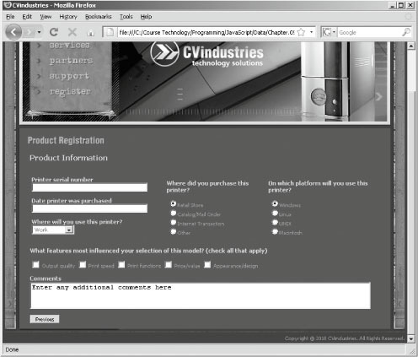
Saving State Information with Hidden Form Fields (cont’d.)
Figure 9-4 Product Information form of the Printer
Product Registration Web page
JavaScript, Fifth Edition

Slide 11
Saving State Information with Hidden Form Fields (cont’d.)
  Add hidden form fields to top frame of the Printer Product Registration frameset
  Copy form field values in Customer Information and Product Information documents to hidden form fields in the Printer Product Registration frameset top frame
  Add code to populate CustomerInfo.html and ProductInfo.html files
  Add code to Product Information document that submits the Printer Product Registration to the FormProcessor.html document
JavaScript, Fifth Edition

Slide 12
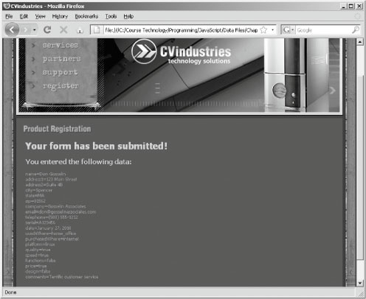
Saving State Information with Hidden Form Fields (cont’d.)
Figure 9-5 Data submitted from the Product
Registration page
JavaScript, Fifth Edition

Slide 13
Saving State Information with Query Strings
Query string
  Set of name=value pairs
    Appended to a target URL
  Consists of a single text string
    Contains one or more pieces of information
Passes information from one Web page to another
JavaScript, Fifth Edition

Slide 14
Saving State Information with Query Strings (cont’d.)
Passing data with a query string
  Add a question mark (?) immediately after a URL
    Followed by the query string (in name=value pairs) for the information to preserve
  Ampersands (&)
    Separates individual name=value pairs within the query string
  Example:
    <a href="http://www.URL.com/TargetPage.html?
    firstName=Don&lastName=Gosselin&occupation=writer">
    Link Text</a>
JavaScript, Fifth Edition

Slide 15
Saving State Information with Query Strings (cont’d.)
  Passed query string assigned to target Web page Location object search property
    search property of the Location object contains a URL’s query or search parameters
From preceding example:
  Query string
    "?firstName=Don&lastName=Gosselin&occupation=writer”
  Available as the value of the search property of the Location object
    After TargetPage.html document opens
JavaScript, Fifth Edition

Slide 16
Saving State Information with Query Strings (cont’d.)
Remove the question mark
  Using the substring() method combined with the length property
  Example:
    // Assigns the query string to the queryData variable
    var queryData = location.search;
    // Removes the opening question mark from the string
    queryData = queryData.substring(1,
    queryData.length)
JavaScript, Fifth Edition

Slide 17
Saving State Information with Query Strings (cont’d.)
Convert individual pieces of information into array elements
  Using the split() method
  Example:
    Convert the information in the queryData variable into an array named queryArray[]
      // splits queryData into an array
      var queryArray = queryData.split("&");
JavaScript, Fifth Edition

Slide 18
Saving State Information with Query Strings (cont’d.)
// Assigns the query string to queryData
var queryData = location.search;
// Removes the opening question mark from the string
queryData = queryData.substring(1, queryData.length);
// splits queryData into an array
var queryArray = queryData.split("&");
for (var i=0; i<queryArray.length; ++i) {
document.write(queryArray[i] + "<br />");
}
JavaScript, Fifth Edition

Slide 19
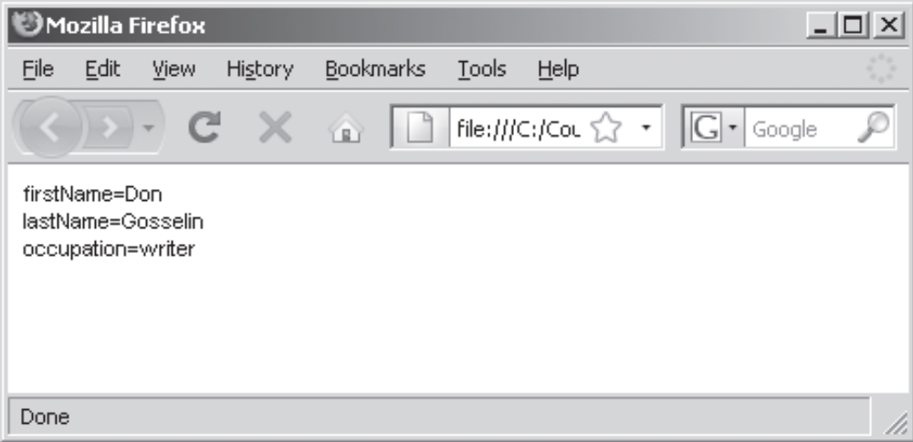
Saving State Information with Query Strings (cont’d.)
  location.search property in the preceding code containing the following string value:
    firstName=Don&lastName=Gosselin&occupation=writer
Figure 9-6 Parsing script in a Web browser
JavaScript, Fifth Edition

Slide 20
Saving State Information with Cookies
Query strings and hidden form fields temporarily maintain state information
Cookies
  Small pieces of information about a user
  Stored by a Web server in text files
  Stored on the user’s computer
When Web client visits a Web server
  Saved cookies sent from client to the server
Temporary cookies
  Available only for current browser session
JavaScript, Fifth Edition

Slide 21
Saving State Information with Cookies (cont’d.)
Persistent cookies
  Remain available beyond current browser session
    Stored in a text file on a client computer
Limitations on the use of cookies
  Server or domain can store a maximum of 20 cookies
  Total cookies per browser cannot exceed 300
  Largest cookie size is 4 kilobytes
JavaScript, Fifth Edition

Slide 22
Creating and Modifying Cookies
Use the cookie property of the Document object
  Creates cookies in name=value pairs
  Syntax
    document.cookie = name + "=" + value;
Cookie property created with a required name attribute and four optional attributes:
  expires, path, domain, secure
JavaScript, Fifth Edition

Slide 23
Creating and Modifying Cookies (cont’d.)
name attribute
  Only required parameter
  Specifies cookie’s name=value pair
  Cookies created with only the name attribute:
    Temporary cookies
  cookie property adds another entry to a list of cookies
  Example: build a list of cookies
    document.cookie = "firstName=" + "Don";
    document.cookie = "lastName=" + "Gosselin";
    document.cookie = "occupation=" + "writer";
JavaScript, Fifth Edition

Slide 24
Creating and Modifying Cookies (cont’d.)
  Cookies cannot include semicolons or special characters
    Can use special characters in cookies if using encoding
  Encoding involves converting special characters in a text string
    To corresponding hexadecimal ASCII value preceded by a percent sign
JavaScript, Fifth Edition

Slide 25
Creating and Modifying Cookies (cont’d.)
  encodeURIComponent() function
    Used for encoding the individual parts of a URI
    Converts special characters in the individual parts of a URI to corresponding hexadecimal ASCII value
    Syntax: encodeURIComponent(text);
  decodeURIComponent() function
    Counterpart of encodeURIComponent() function
    Syntax: decodeURIComponent(text);
JavaScript, Fifth Edition

Slide 26
Creating and Modifying Cookies (cont’d.)
  For older browsers
    Manually encode and decode cookies
  Example exercise:
    Modify Customer Information and Product Information forms so that fields saved in temporary cookies instead of in query strings
JavaScript, Fifth Edition

Slide 27
Creating and Modifying Cookies (cont’d.)
expires attribute
  Determines how long a cookie can remain on a client system before being deleted
  Cookies created without this attribute
    Available current browser session only
  Syntax: expires=date
    name=value pair and the expires=date pair separated by a semicolon
  Do not encode expires attribute
JavaScript, Fifth Edition

Slide 28
Creating and Modifying Cookies (cont’d.)
  Can manually type a string in UTC format or:
    Can create string with the Date object
  Use the toUTCString() method to convert the Date object to a string
  Example:
var expiresDate = new Date();
expiresDate.setFullYear(expiresDate.getFullYear() + 1);
document.cookie = "firstName=" + encodeURIComponent("Don")
+ "; expires=" + expiresDate.toUTCString();
JavaScript, Fifth Edition

Slide 29
Creating and Modifying Cookies (cont’d.)
Deleting cookies from your browser
  Unused persistent cookies
    Sometimes interfere with JavaScript cookie program execution
JavaScript, Fifth Edition

Slide 30
Creating and Modifying Cookies (cont’d.)
Configuring availability of cookies to other Web pages on the server
path attribute
  Determines availability of a cookie to other Web pages on a server
  Default: cookie available to all Web pages in the same directory
  To make cookie available to all directories on a server
    Use a slash
JavaScript, Fifth Edition

Slide 31
Creating and Modifying Cookies (cont’d.)
  Example:
    document.cookie = "firstName="
    + encodeURIComponent("Don"
    + ";path=/marketing");
  Example:
    document.cookie = "firstName="
    + encodeURIComponent("Don" + ";path=/");
  Cookies from other programs stored in the same directory
    Can cause JavaScript cookie program to run erratically
JavaScript, Fifth Edition

Slide 32
Creating and Modifying Cookies (cont’d.)
Sharing cookies across a domain
domain attribute
  Used for sharing cookies across multiple servers in the same domain
  Cannot share cookies outside of a domain
  Example:
    document.cookie = "firstName="
    + encodeURIComponent("Don"
    + ";domain=.gosselin.com");
JavaScript, Fifth Edition

Slide 33
Creating and Modifying Cookies (cont’d.)
Securing cookie transmissions
secure attribute
  Indicates cookie can only be transmitted across a secure Internet connection
    Using HTTPS or another security protocol
  Example:
    document.cookie = "firstName="
    + encodeURIComponent("Don"
    + ";secure=true");
JavaScript, Fifth Edition

Slide 34
Reading Cookies with JavaScript
Parsing a cookie
  Decode it using decodeURIComponent() function
  Use the String object methods to extract individual name=value pairs
  Similar to parsing query strings
    Do not need to remove the question mark at the beginning of the string
    Individual cookies separated by a semicolon and a space instead of ampersands
JavaScript, Fifth Edition

Slide 35
Reading Cookies with JavaScript (cont’d.)
  Example:
    Create three encoded cookies
    Read them from the cookie property, decode them
    Use the split() method to copy each name=value pair into cookieArray[] array elements
    Determine which cookie holds value needed
    for loop cycles through each array element using an if statement and several string methods checking if name portion of each name=value pair equals team
JavaScript, Fifth Edition

Slide 36
Reading Cookies with JavaScript (cont’d.)
document.cookie = "city=" + encodeURIComponent("Boston");
document.cookie = "team="
+ encodeURIComponent("Red Sox");
document.cookie = "sport="
+ encodeURIComponent("baseball");
var cookieString = decodeURIComponent(
document.cookie);
var cookieArray = cookieString.split("; ");
JavaScript, Fifth Edition

Slide 37
Reading Cookies with JavaScript (cont’d.)
var yourTeam;
for (var count = 0; count < 3; ++count) {
yourTeam = cookieArray[count];
if (yourTeam.substring(0,yourTeam.indexOf("="))
== "team") {
document.writeln("Your team is the "
+ yourTeam.substring(
yourTeam.indexOf("=")+ 1,
yourTeam.length));
break;
}
}
JavaScript, Fifth Edition

Slide 38
Deleting Cookies with JavaScript
Not intuitive
  Must set cookie expiration to a date in the past
Example:
  Delete firstName cookie by setting its expires attribute to one week ago
    var expiresDate = new Date();
    expiresDate.setDate(expiresDate.getDate() - 7);
    document.cookie = "firstName=don" + "; expires="
    + expiresDate.toUTCString();
JavaScript, Fifth Edition

Slide 39
Understanding Security Issues
Security threats
  Viruses, worms, data theft by hackers
Consider Web server security and secure coding issues
Web server security technologies
  Firewalls
  Secure Socket Layer (SSL)
JavaScript programs downloaded and execute locally
Section discusses security issues related to Web browsers and JavaScript
JavaScript, Fifth Edition

Slide 40
Secure Coding with JavaScript
Secure coding or defensive coding
  Writing code to minimize any intentional or accidental security issues
All code: insecure unless proven otherwise
No magic formula for writing secure code
JavaScript, Fifth Edition

Slide 41
JavaScript Security Concerns
Security areas of most concern
  Protection of a Web page and JavaScript program against malicious tampering
  Privacy of individual client information
  Protection of the local file system of the client or Web site from theft or tampering
Another security concern
  Privacy of individual client information in the Web browser window
Important JavaScript security feature
  Lack of certain types of functionality
JavaScript, Fifth Edition

Slide 42
JavaScript Security Concerns (cont’d.)
Missing functionalities
  File manipulation
  Create a network connection
  Cannot run system commands or execute programs on a client
JavaScript, Fifth Edition

Slide 43
The Same Origin Policy
Restricts how JavaScript code in one window or frame accesses a Web page
  In another window or frame on a client computer
To view and modify elements in other windows and frames
  They must have the same protocol and exist on the same Web server
Same origin policy applies to:
  The domain name
  The server on which a document located
JavaScript, Fifth Edition

Slide 44
The Same Origin Policy (cont’d.)
Policy prevents:
  Malicious scripts from modifying content of other windows and frames
  Theft of private browser information and information displayed on secure Web pages
Policy protects integrity of Web page design Example exercise:
  Create a frame set where one frame uses JavaScript code to try to change the status bar text of another frame, using the status property of the Document object
JavaScript, Fifth Edition

Slide 45
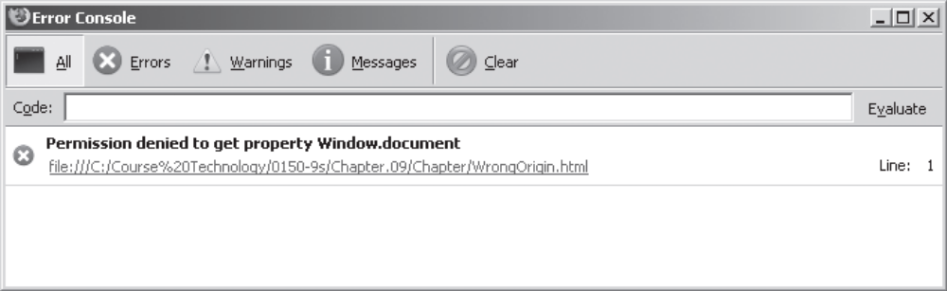
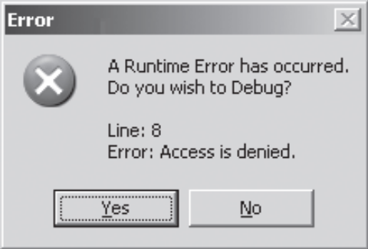
The Same Origin Policy (cont’d.)
Figure 9-7 Firefox error message demonstrating the same
origin policy
Figure 9-8 Internet Explorer error message
demonstrating the same origin policy
JavaScript, Fifth Edition

Slide 46
The Same Origin Policy (cont’d.)
domain property of the Document object
  Changes origin of a document to its root domain name
  Allows documents from different origins in the same domain to access each other’s elements and properties
JavaScript, Fifth Edition

Slide 47
Summary
State information
  Information about individual visits to a Web site is called
HTTP originally designed to be stateless
Can hide information from users in a hidden form field
Most common tools for maintaining state information:
  Hidden form fields, query strings, cookies
Query string
  Set of name=value pairs appended to a target URL
JavaScript, Fifth Edition

Slide 48
Summary (cont’d.)
Cookies
  Small pieces of information about a user
  Stored by a Web server
  Can be temporary or persistent
Cookie property created with a required name attribute
Can use special characters in cookies if using encoding
encodeURIComponent() function encodes the individual parts of a URI
JavaScript, Fifth Edition

Slide 49
Summary (cont’d.)
When reading a cookie or other text string encoded
  Must first decode it with the decodeURIComponent() function
Cookies: one continuous string that must be parsed
“Secure coding” or “defensive coding”
  Writing code to minimize any intentional or accidental security issues
JavaScript, Fifth Edition

